Slide 1
The Smart Kitchen
Niall McLoughlin
Year 4 - Project Engineering
Bachelor of Engineering (Honours) in Software and Electronic Engineering

Slide 2
Introduction
The Smart Kitchen is a food inventory system designed to help people manage the food in their kitchens. The project uses a barcode scanner to track and store which food items are in your kitchen, and a camera using Optical Character Recognition (OCR) to track best before dates on perishable items. Once all food items are entered they are stored in a ‘digital pantry’, this can be viewed on a mobile application, with recipe ideas being generated based on the user’s food inventory.
The project uses a Raspberry PI 4 with a camera module to read food best before dates, with a one-dimensional barcode scanner being used to enter barcode data. This information is then uploaded to a database which can the accessed via the mobile application. The application is written in JavaScript using React native as a framework, with MongoDB being used to handle the database. Optical Character recognition is achieved using Tesseract and OpenCV.

Slide 3
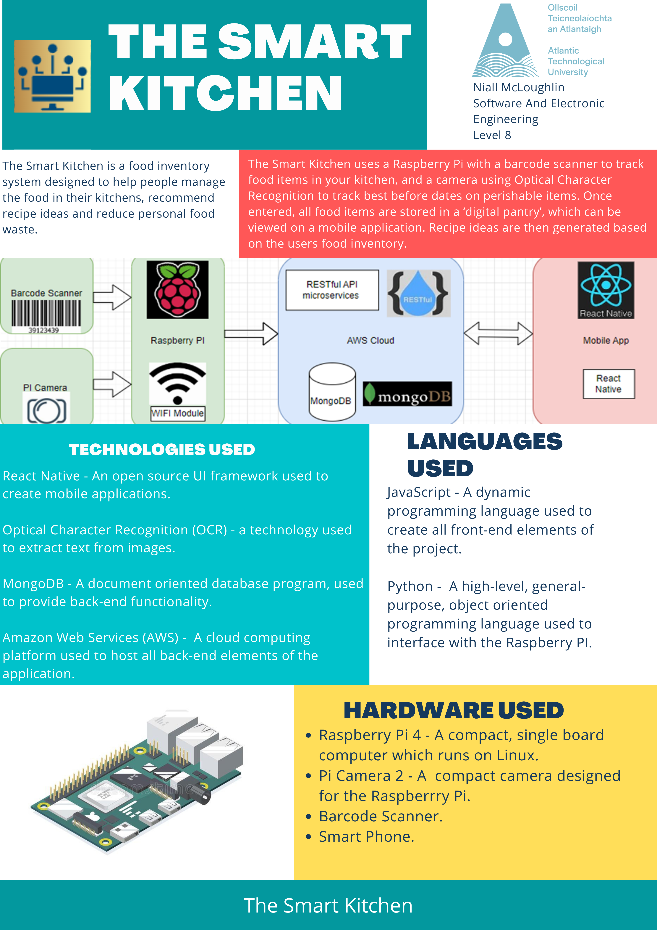
poster

Slide 4
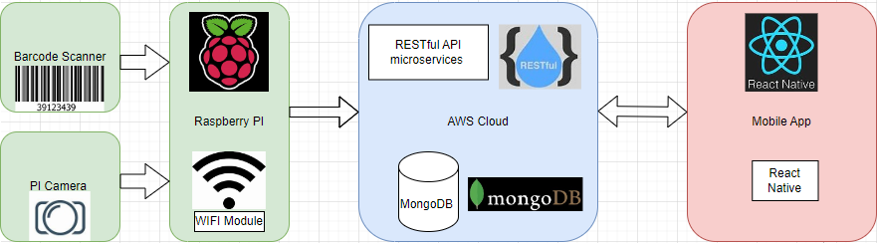
Architecture Diagram

Slide 5
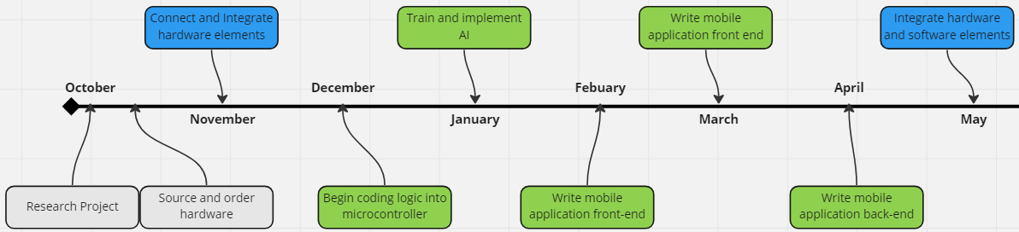
TimeLine
Original
Write code for microcontroller
Actual
Write mobile application back-end
Write code for microcontroller
Train and Implement AI

Slide 6
Project Hardware
React Native – A popular JavaScript UI framework used for developing cross-platform mobile applications.
Visual Studio Code – An open source code editor made by Microsoft.
Node.js – A cross-platform runtime environment for developing sever-side/networking applications.
Open CV – A function library used for implementing real-time computer Vision.
Tesseract – An Optical Character Recognition (OCR) Engine.
Express.js – A back end web application framework used for building Restful API applications.
Mongo DB – A document-oriented (NoSQL) database application.

Slide 7
Languages Used
JavaScript – A scripting Language used to create dynamic User Interfaces for Web and mobile applications.
Python – A general purpose, high-level and multiparadigm programming language used for a wide range of applications.

Slide 8
Project hardware
Raspberry PI – A range single board computers (SBCs) popular for both industrial applications and hobbyists projects, specifically IOT projects.
Pi Camera Module – A camera module designed specifically to interface with the Raspberry PI, which connects through a custom Camera Serial Interface (CSI).
Barcode scanner – A one dimensional (linear code) scanner used to read standard retail barcodes.

Slide 9
Conclusions
The Smart Kitchen was a both a challenging and reward project, an gave me the opportunity to gain a deeper knowledge of not only specific languages and tools, but also software development philosophies and methodologies.
I immensely enjoy working on the project and plan to continue to further improve, and add features to the Smart Kitchen in the future.

Slide 10
THANK YOU!
Please feel free to ask any question you might have

